Slide 1
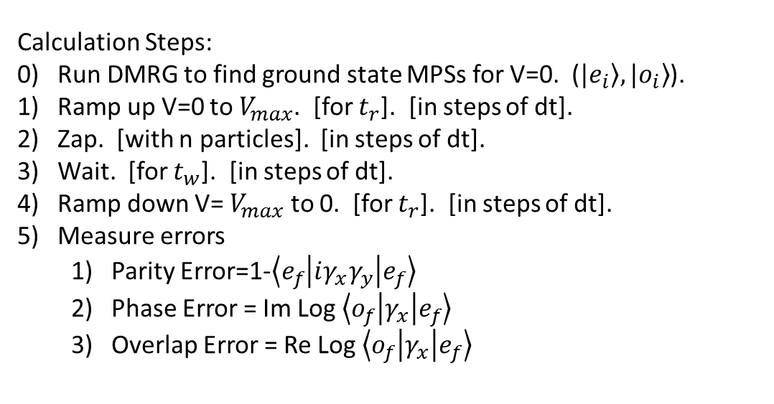
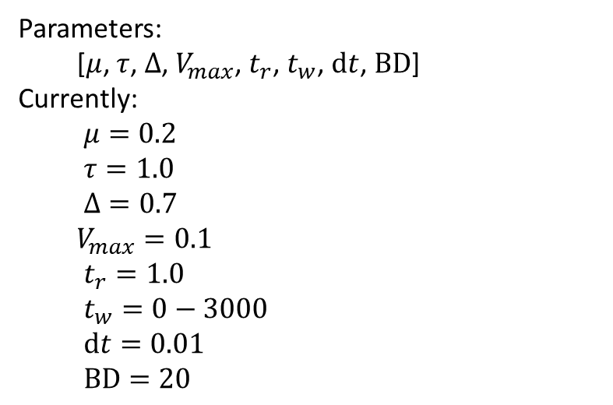
$$H=μ\sum_{i=0}^{L−1}{c_{i}^{†}c_{i}}+τ\sum_{i=0}^{L−1}{(c_{i}^{†}c_{i+1}+c_{i+1}^{†}c_{i})}+Δ\sum_{i=0}^{L−1}{(c_{i}^{†}c_{i+1}^{†}+c_{i+1}c_{i})}+V\sum_{i=0}^{L−1}{c_{i}^{†}c_{i}c_{i+1}^{†}c_{i+1}}$$
Calculation Steps:
0) Run DMRG to find ground state MPSs for V=0. ($\left.|e_{i}\right\rangle ,\left.|o_{i}\right\rangle$).
Ramp up V=0 to $V_{max}$. [for $t_{r}$]. [in steps of dt].
Zap. [with n particles]. [in steps of dt].
Wait. [for $t_{w}$]. [in steps of dt].
Ramp down V= $V_{max}$ to 0. [for $t_{r}$]. [in steps of dt].
Measure errors
Parity Error=1-$\left\langle e_{f} | iγ_{x}γ_{y} | e_{f}\right\rangle$
Phase Error = Im Log $\left\langle o_{f} | γ_{x} | e_{f}\right\rangle$
Overlap Error = Re Log $\left\langle o_{f} | γ_{x} | e_{f}\right\rangle$
Parameters:
[$μ$, $τ$, $Δ$, $V_{max}$, $t_{r}$, $t_{w}$, $dt$, $BD$]
Currently:
$μ=0.2$
$τ=1.0$
$Δ=0.7$
$V_{max}=0.1$
$t_{r}=1.0$
$t_{w}=0−3000$
$dt=0.01$
$BD=20$

Slide 2
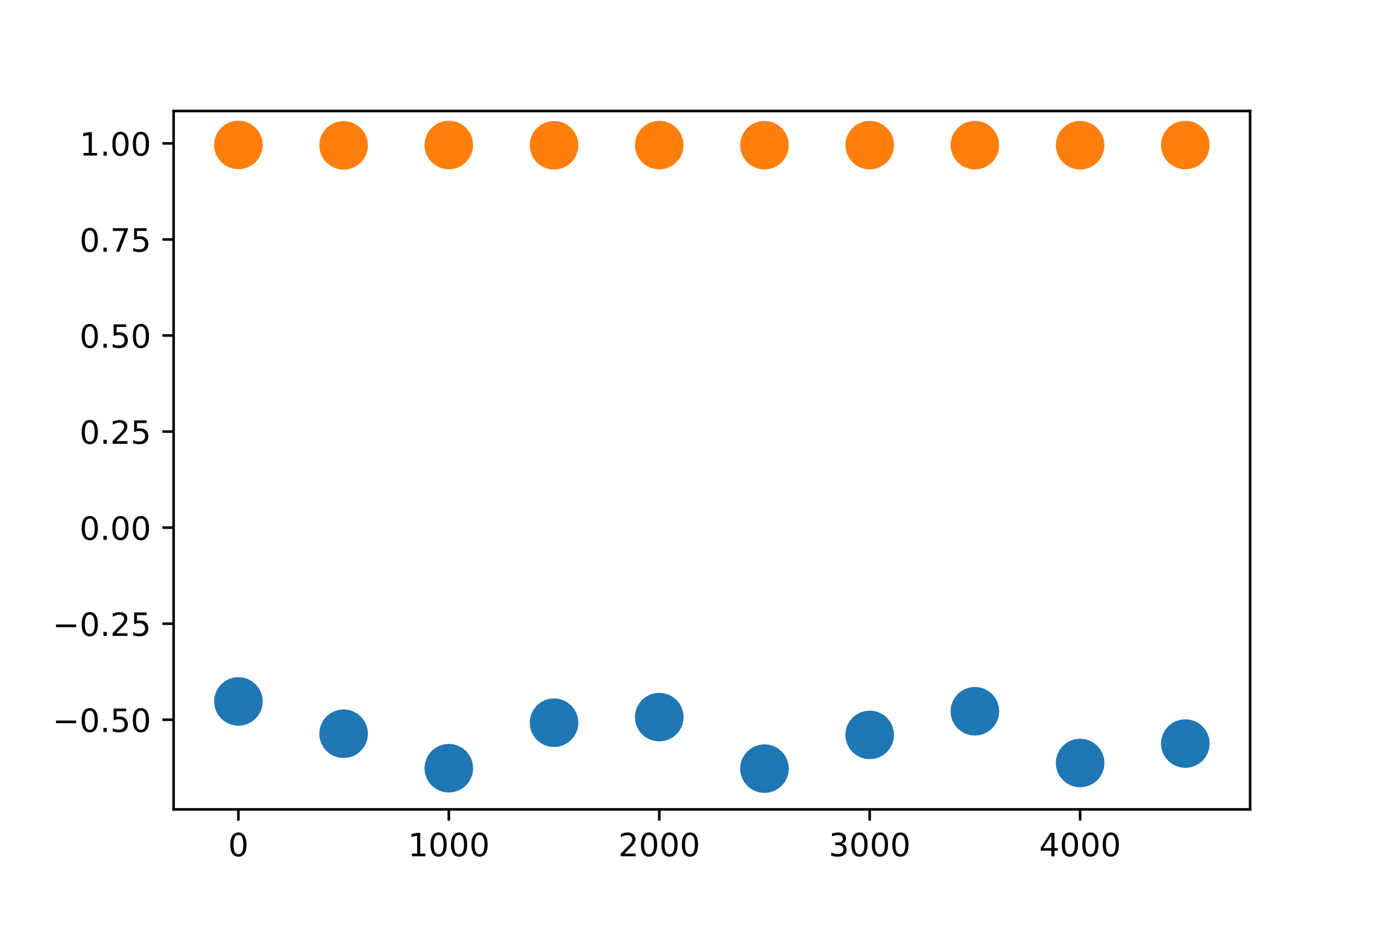
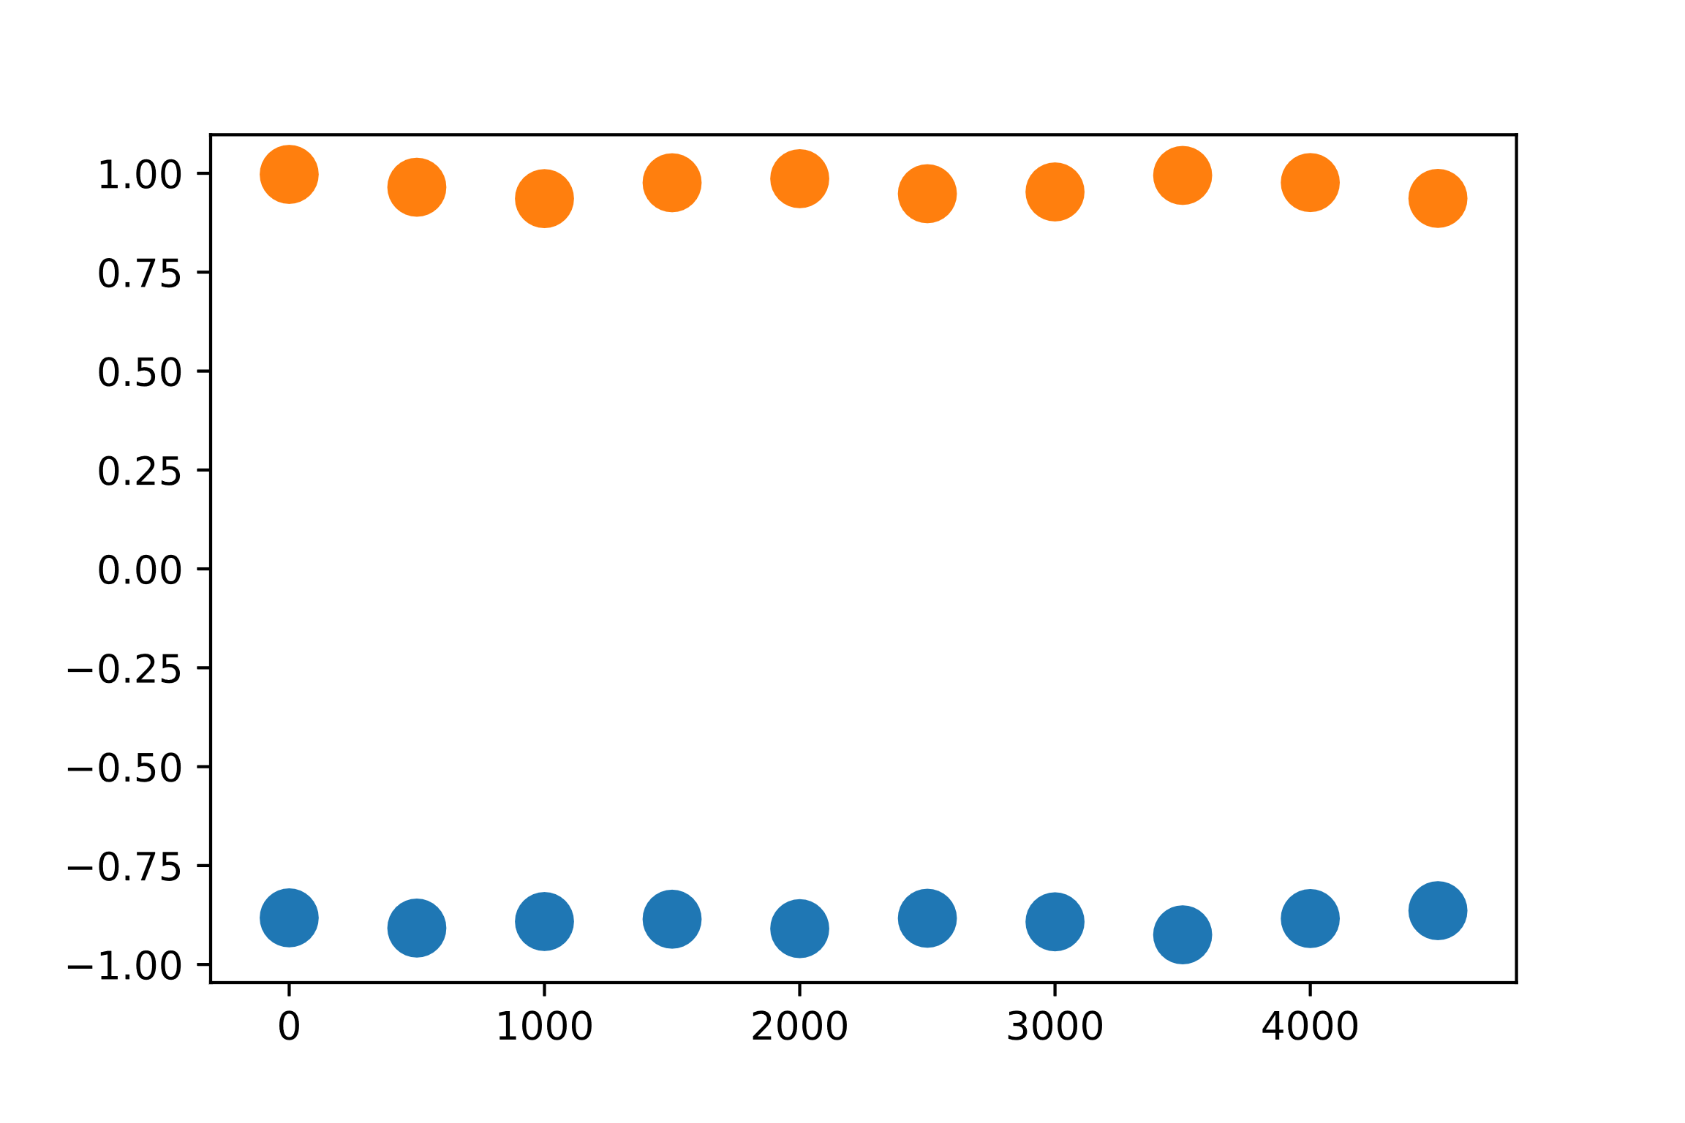
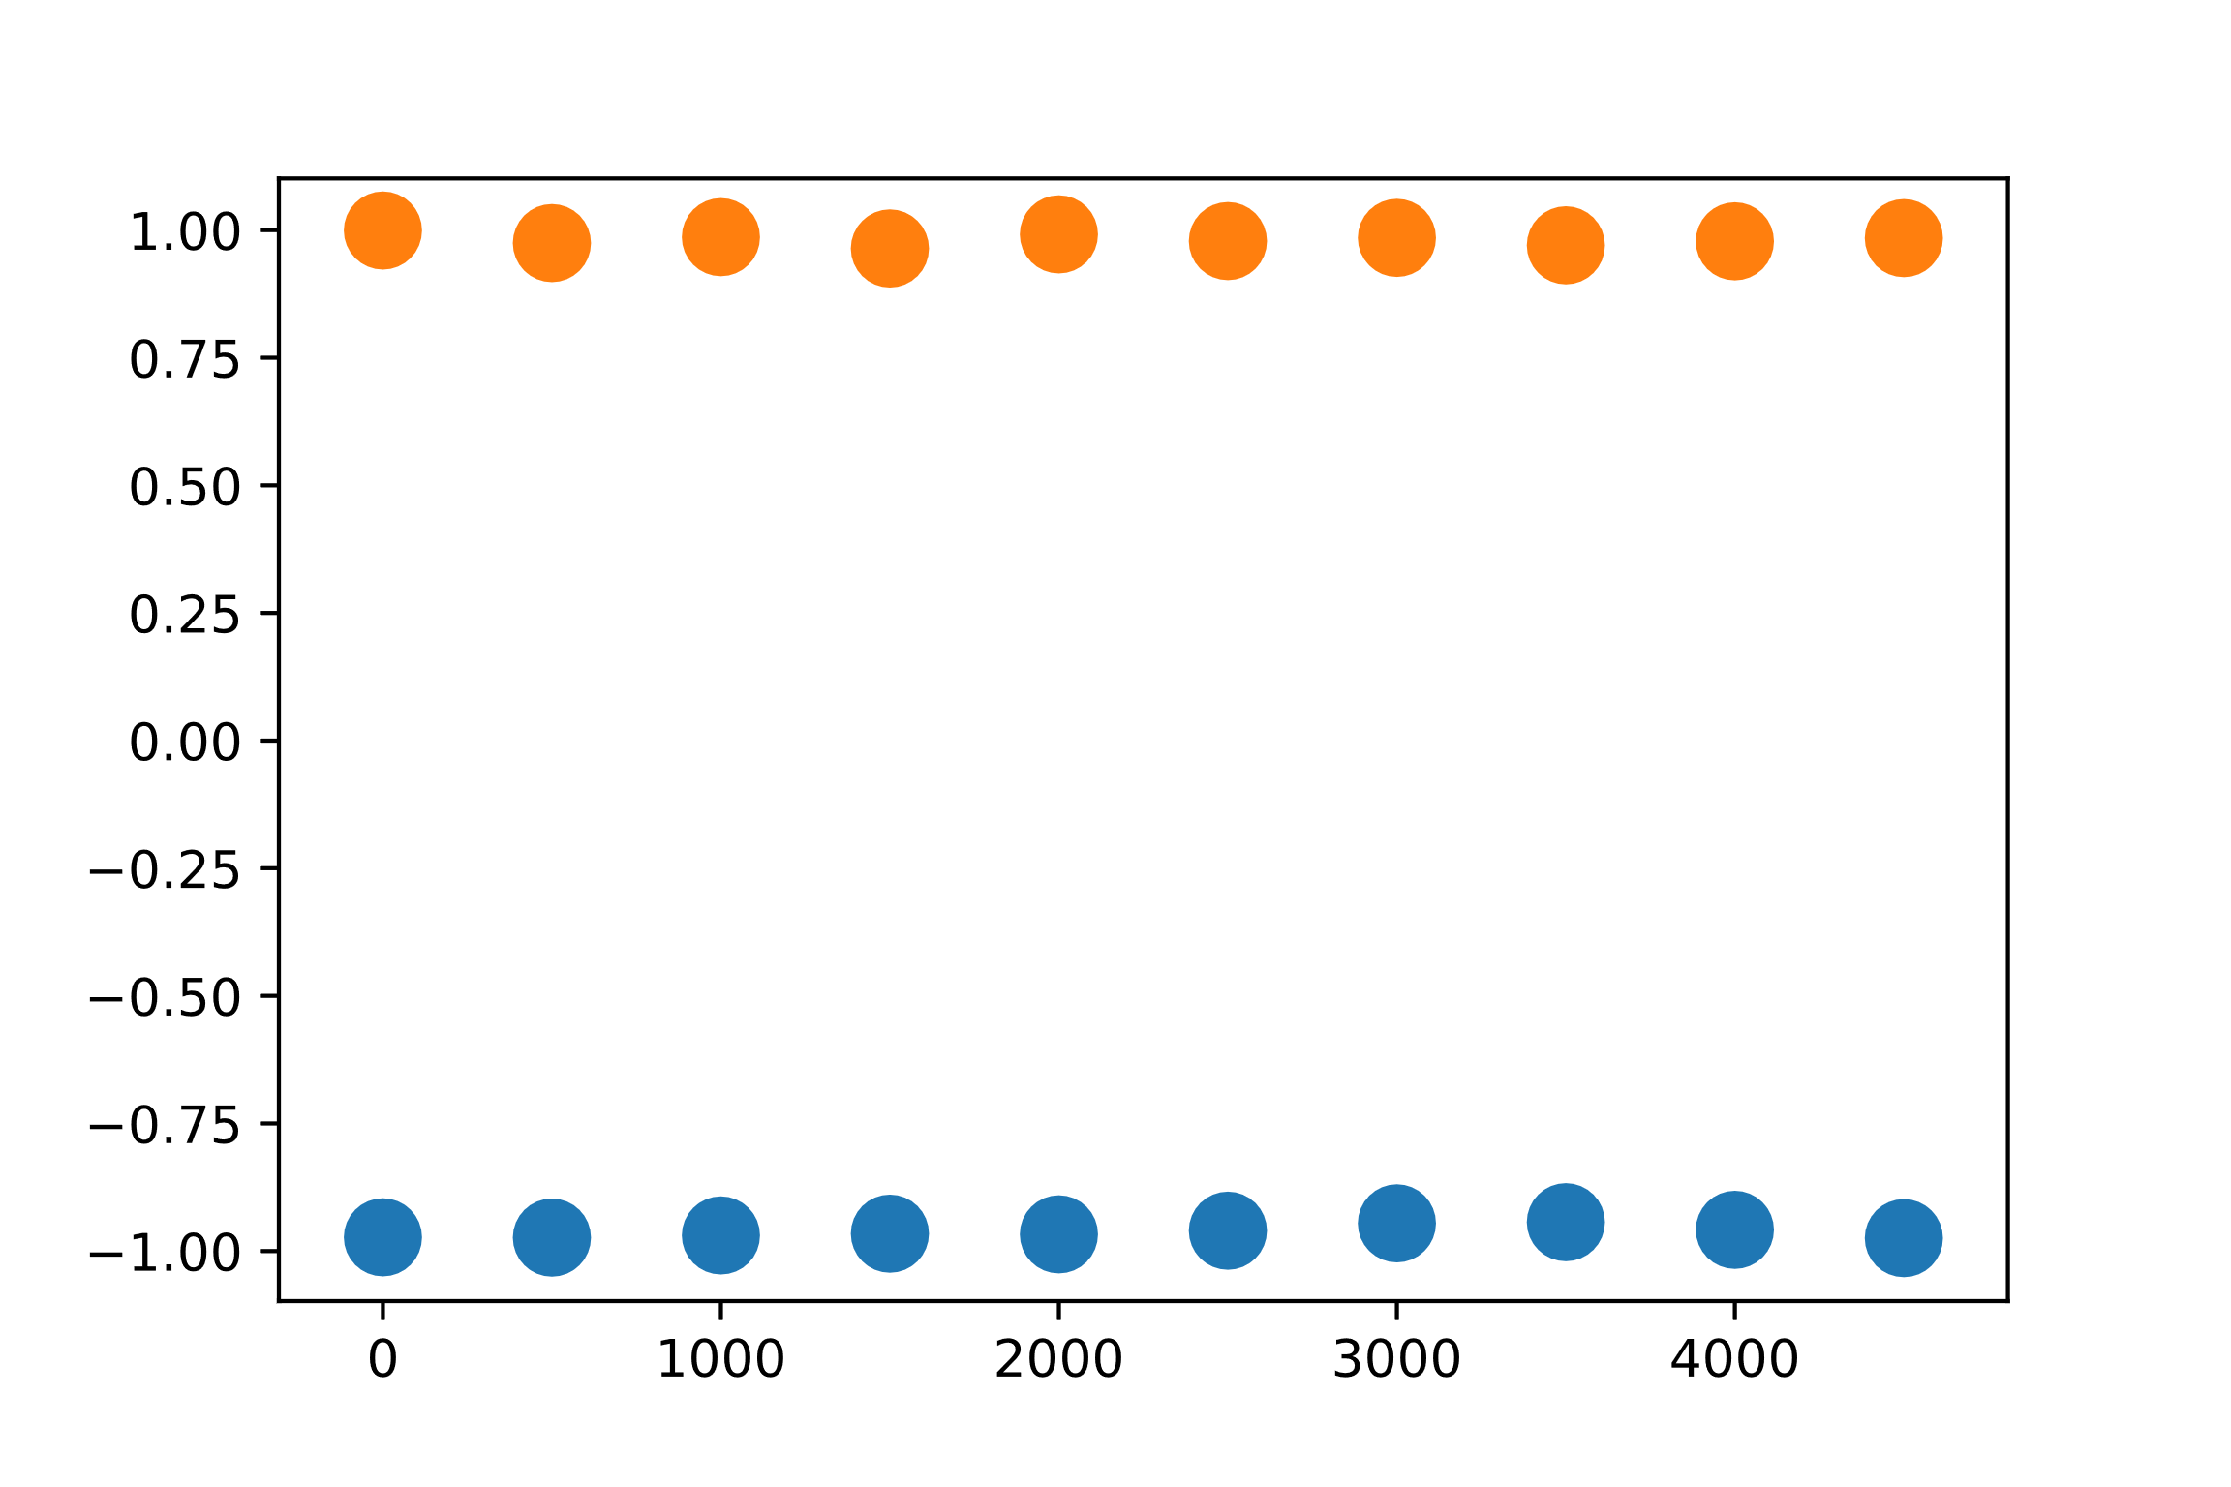
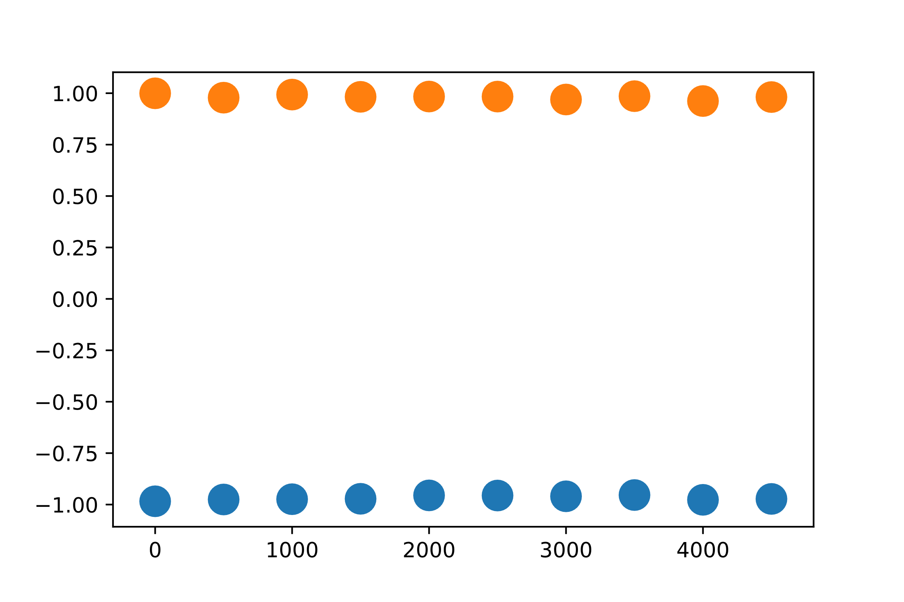
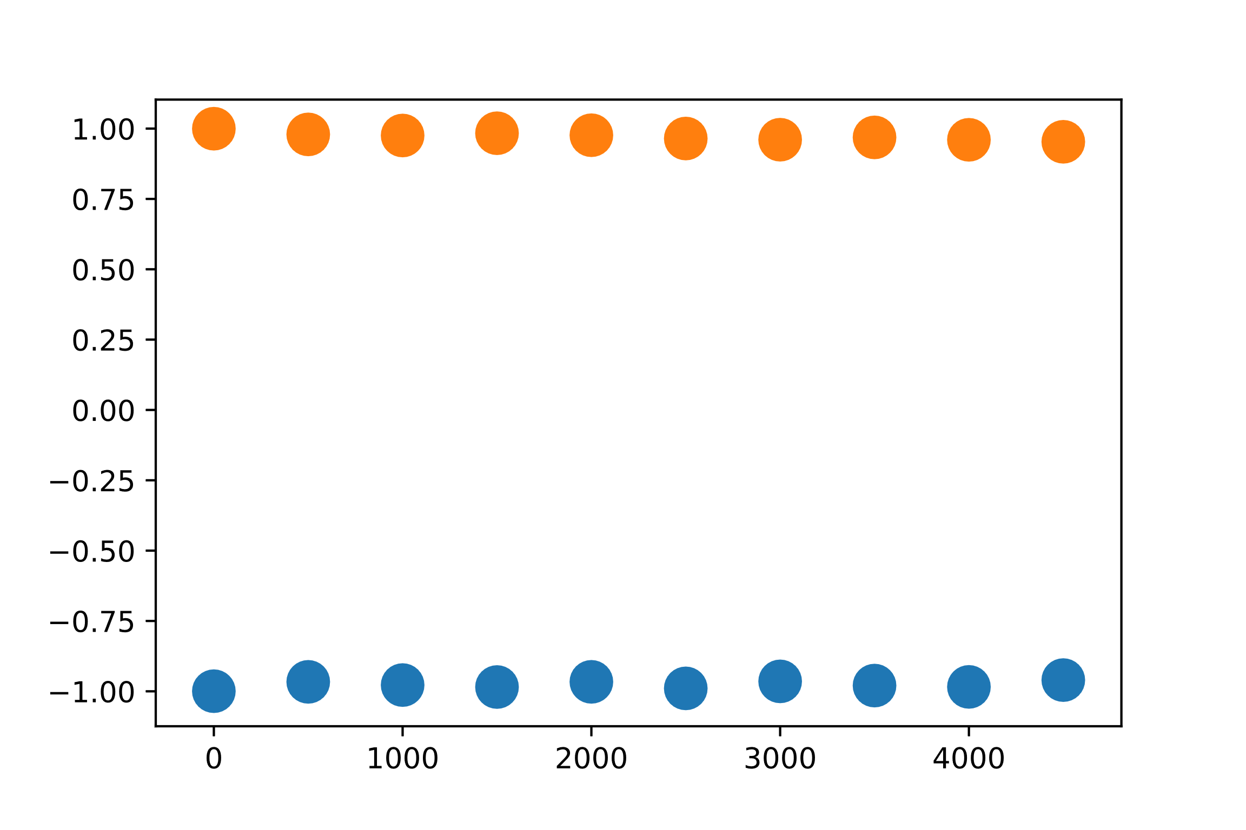
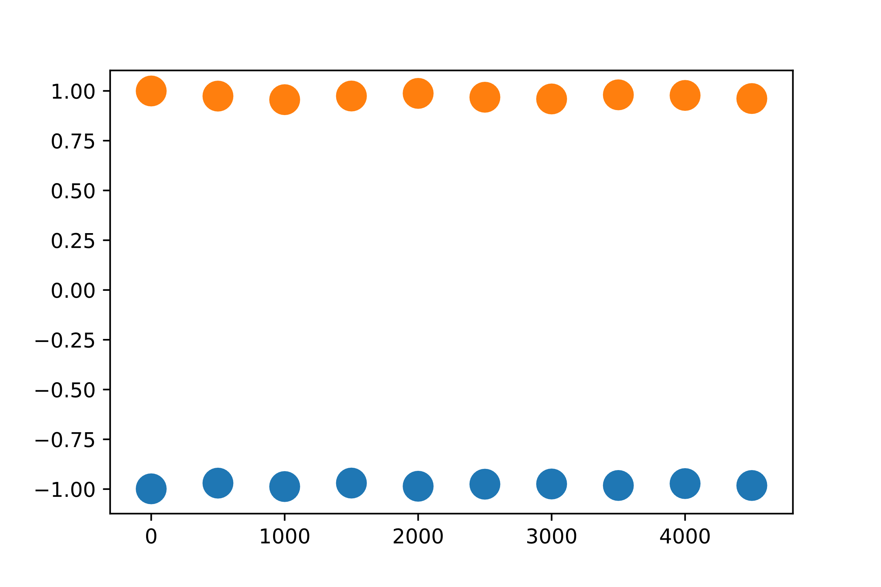
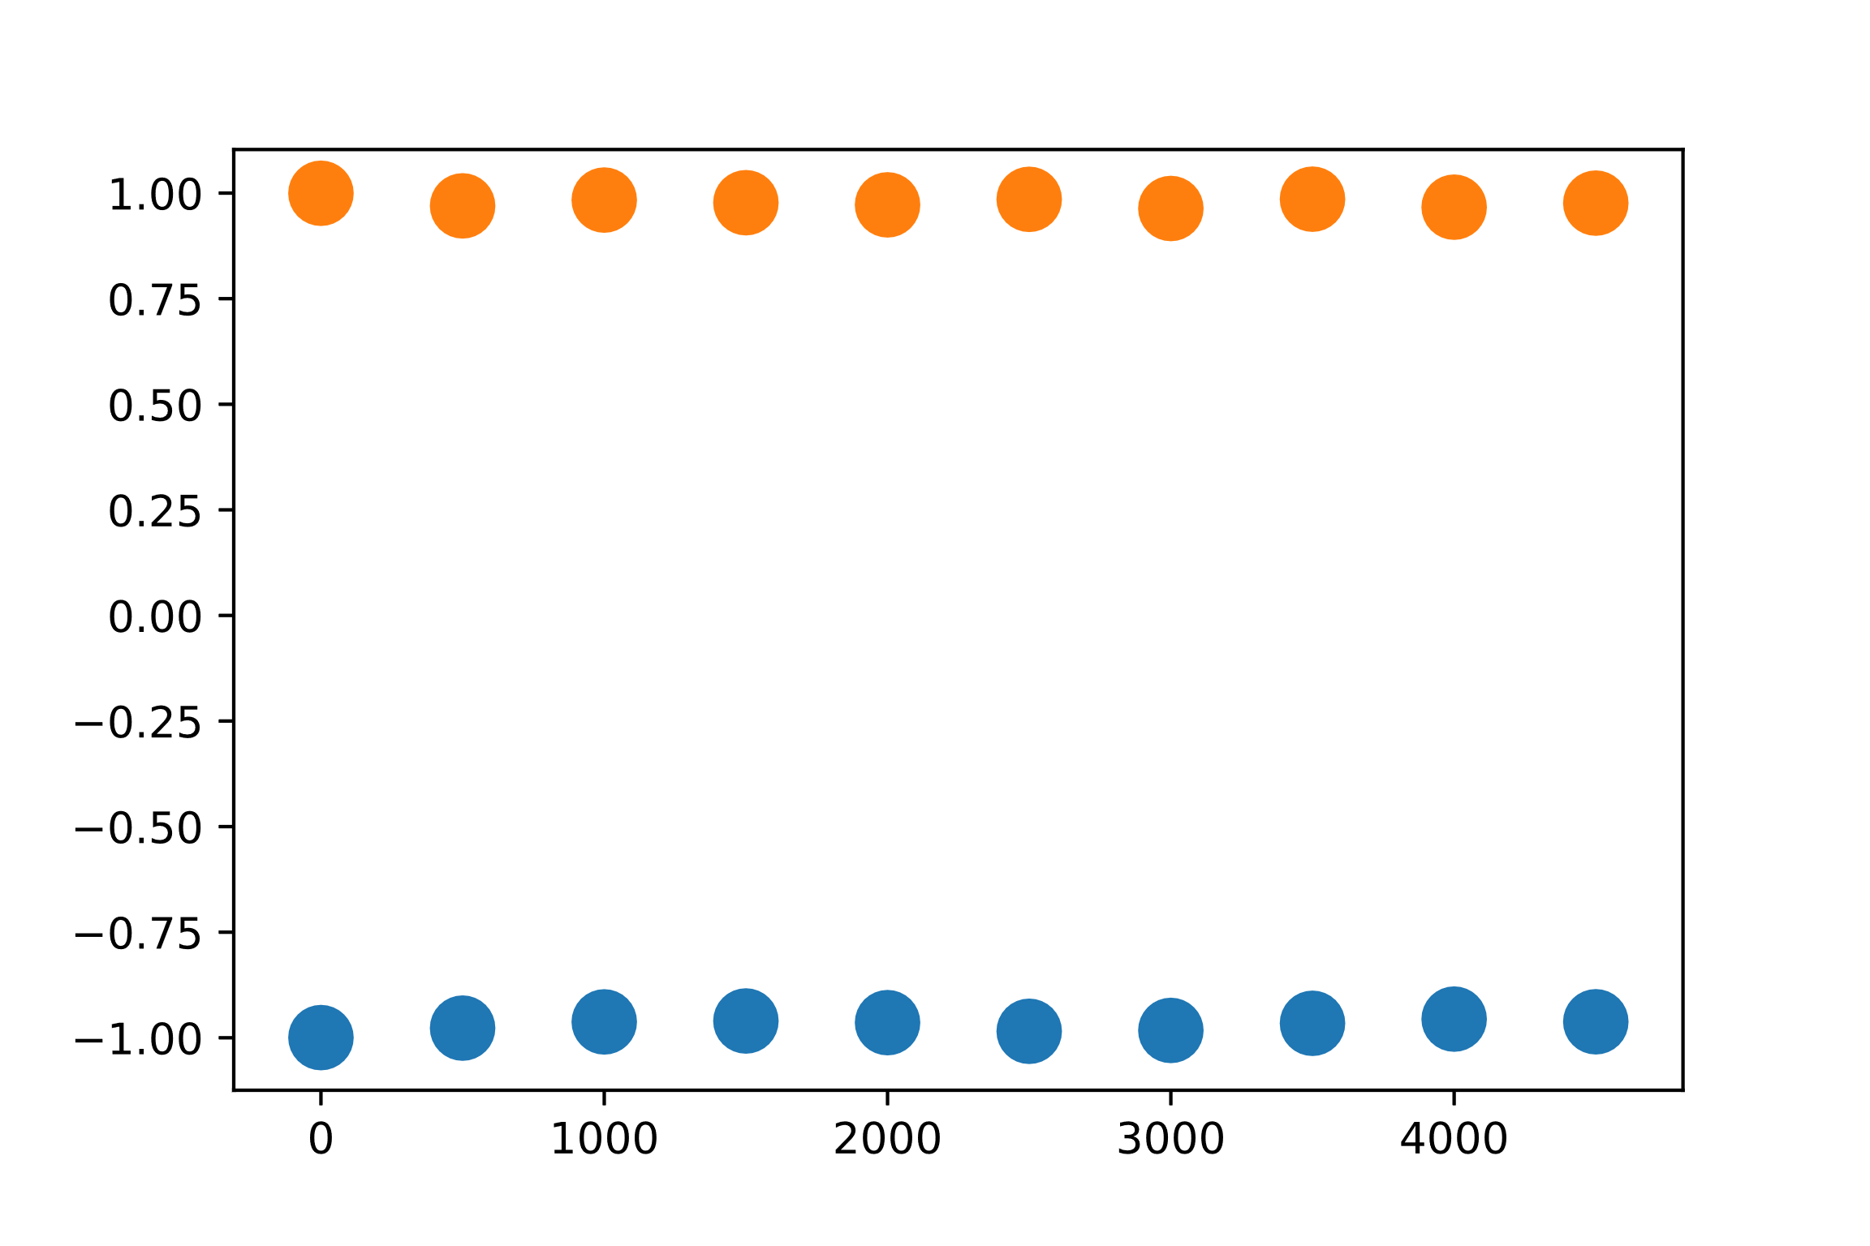
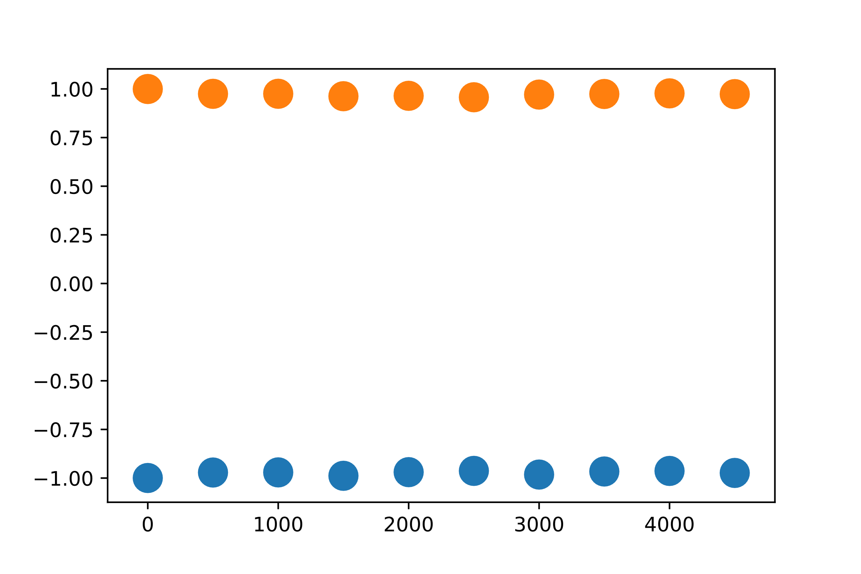
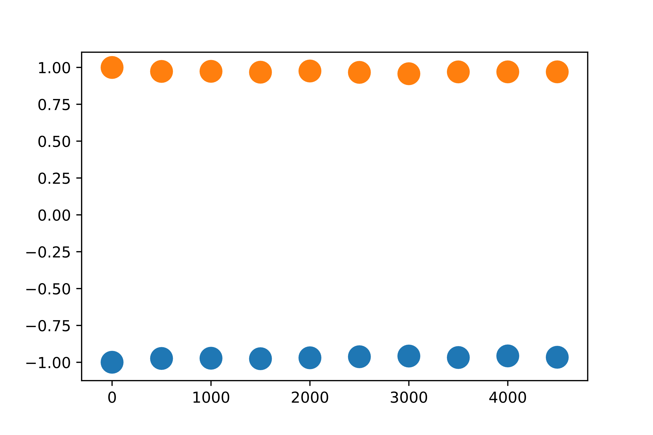
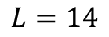
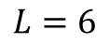
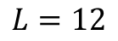
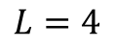
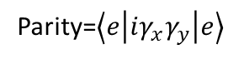
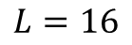
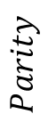
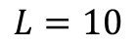
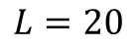
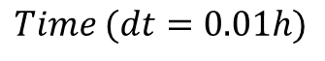
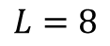
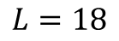
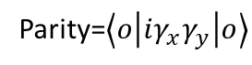
$$L=4$$
$$L=6$$
$$L=8$$
Parity=$\left\langle e | iγ_{x}γ_{y} | e\right\rangle$
$$Parity$$
Parity=$\left\langle o | iγ_{x}γ_{y} | o\right\rangle$
$$Time (dt=0.01h)$$
$$L=10$$
$$L=12$$
$$L=14$$
$$L=16$$
$$L=18$$
$$L=20$$

Slide 3
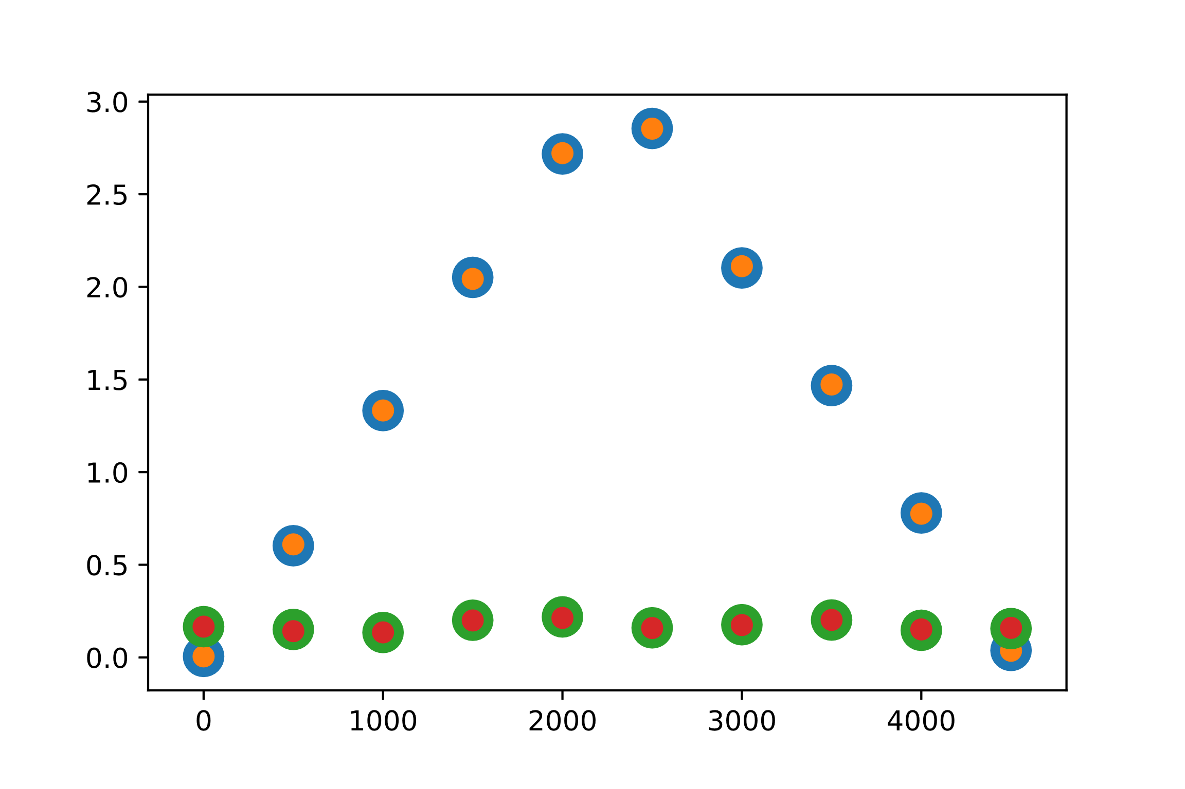
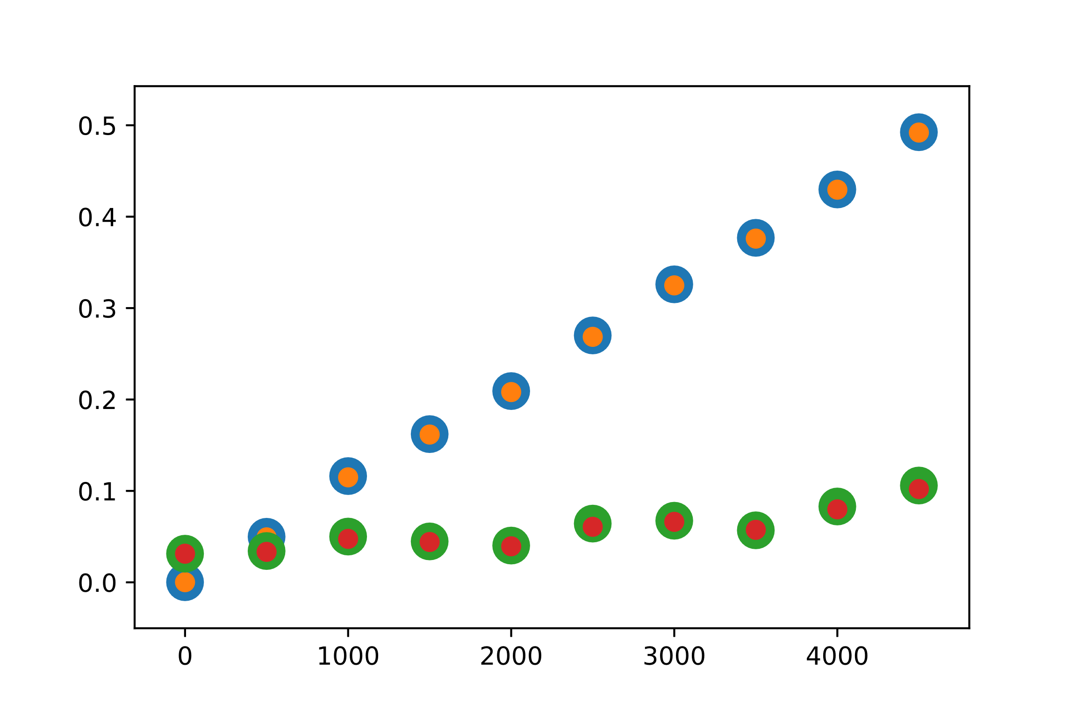
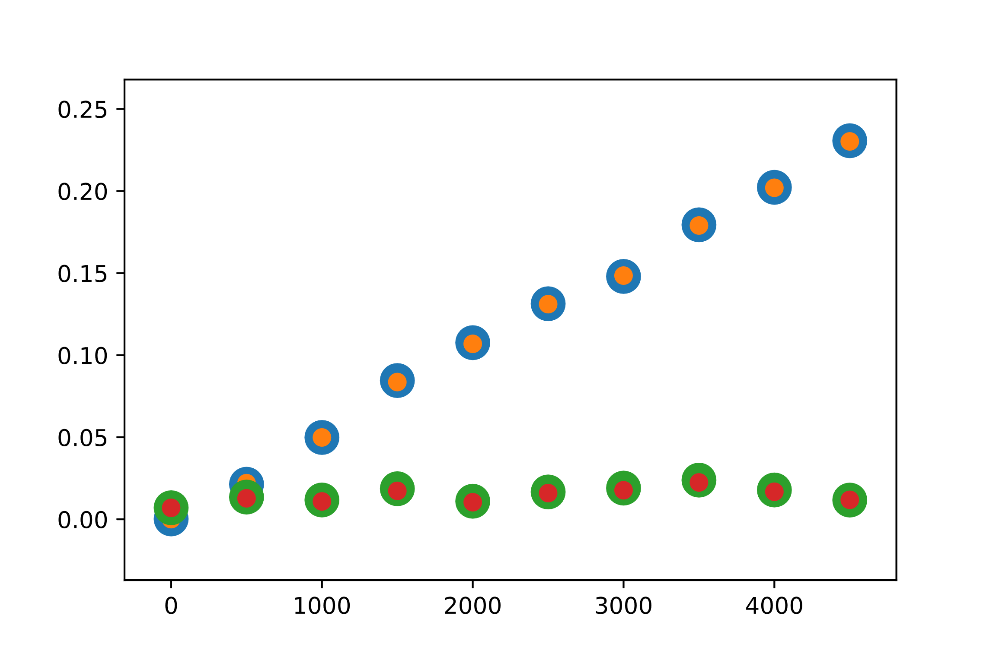
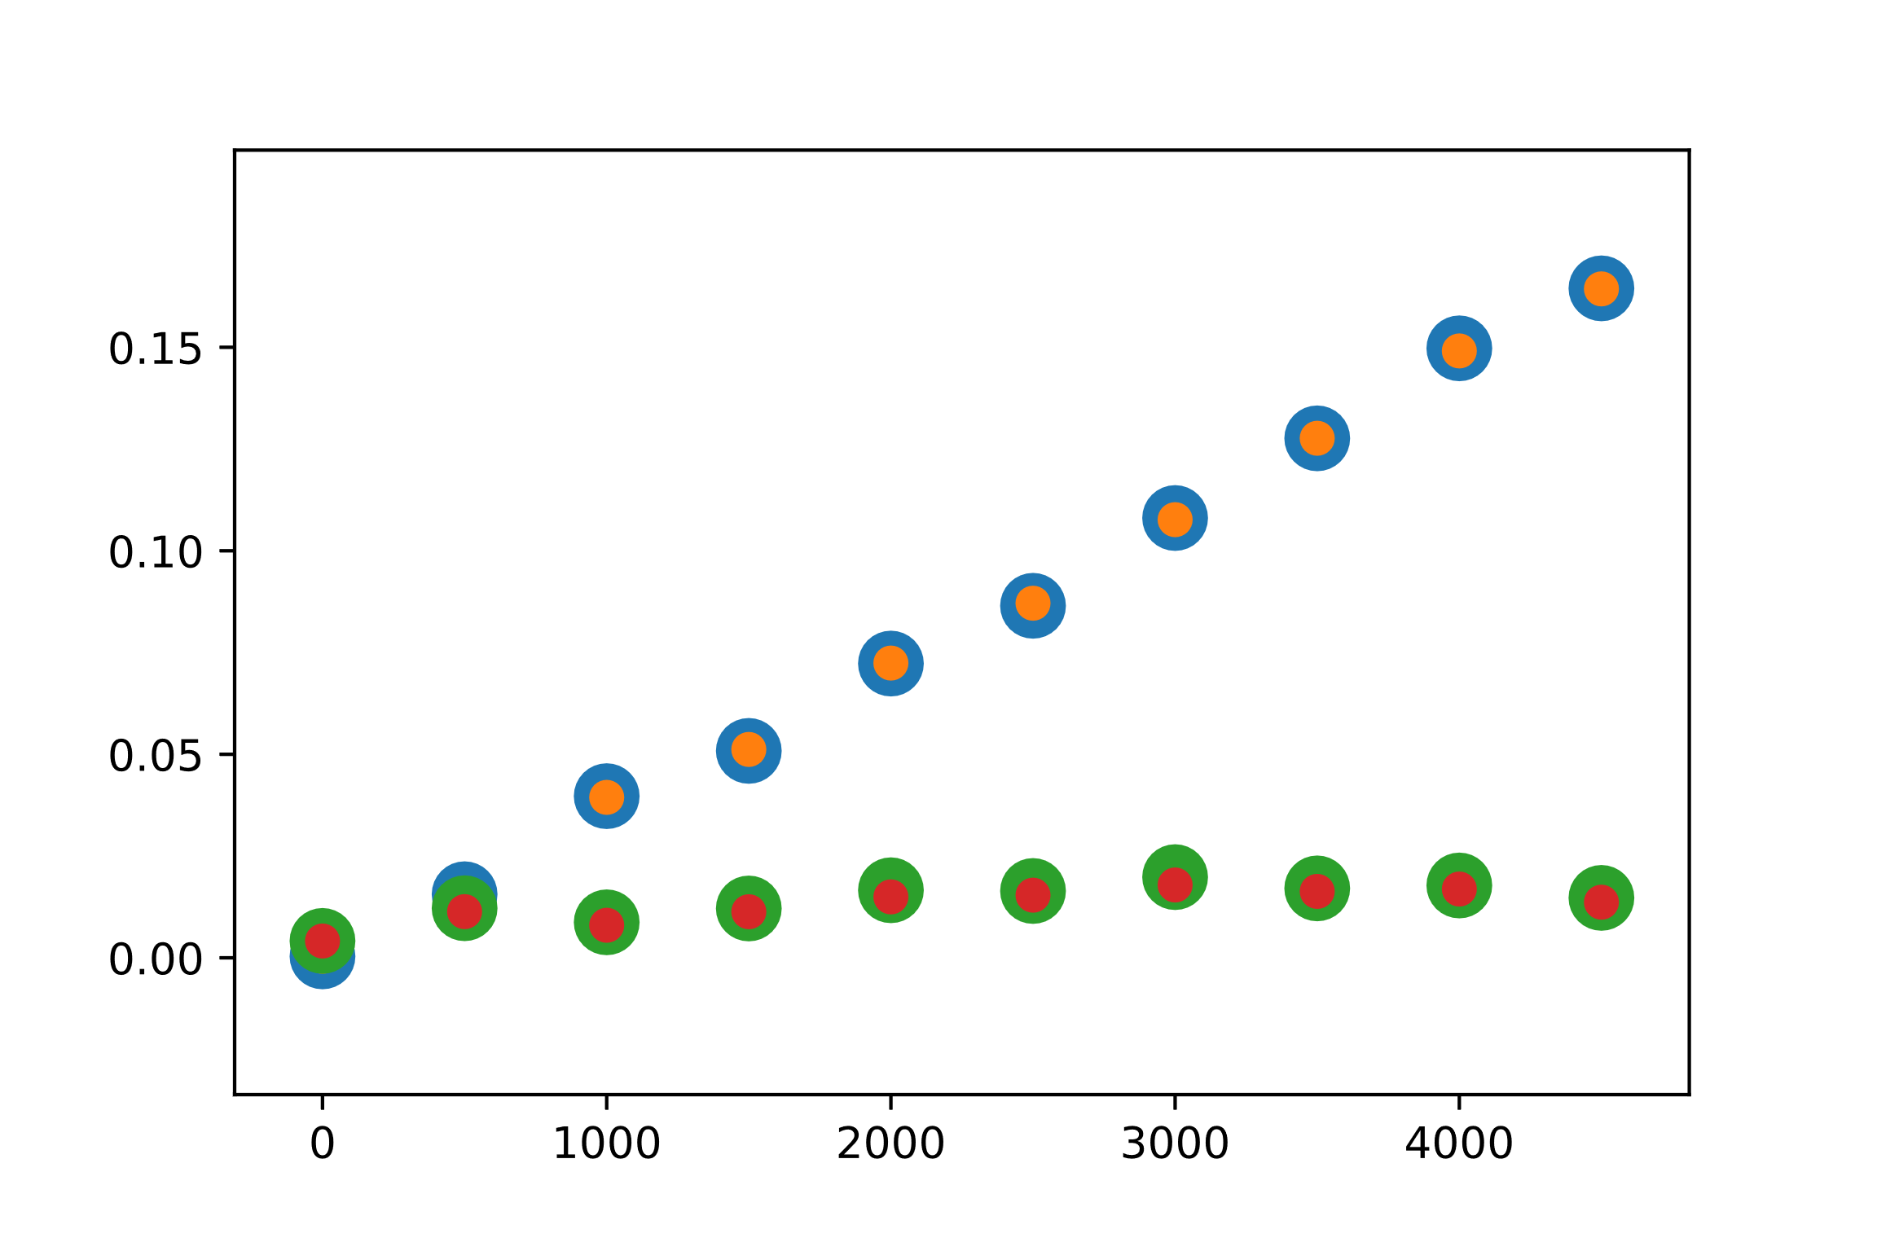
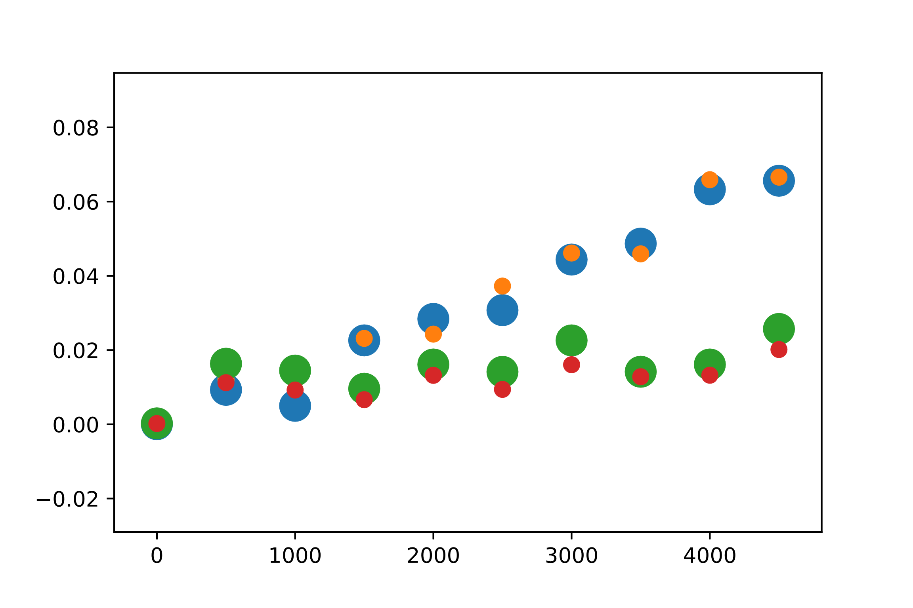
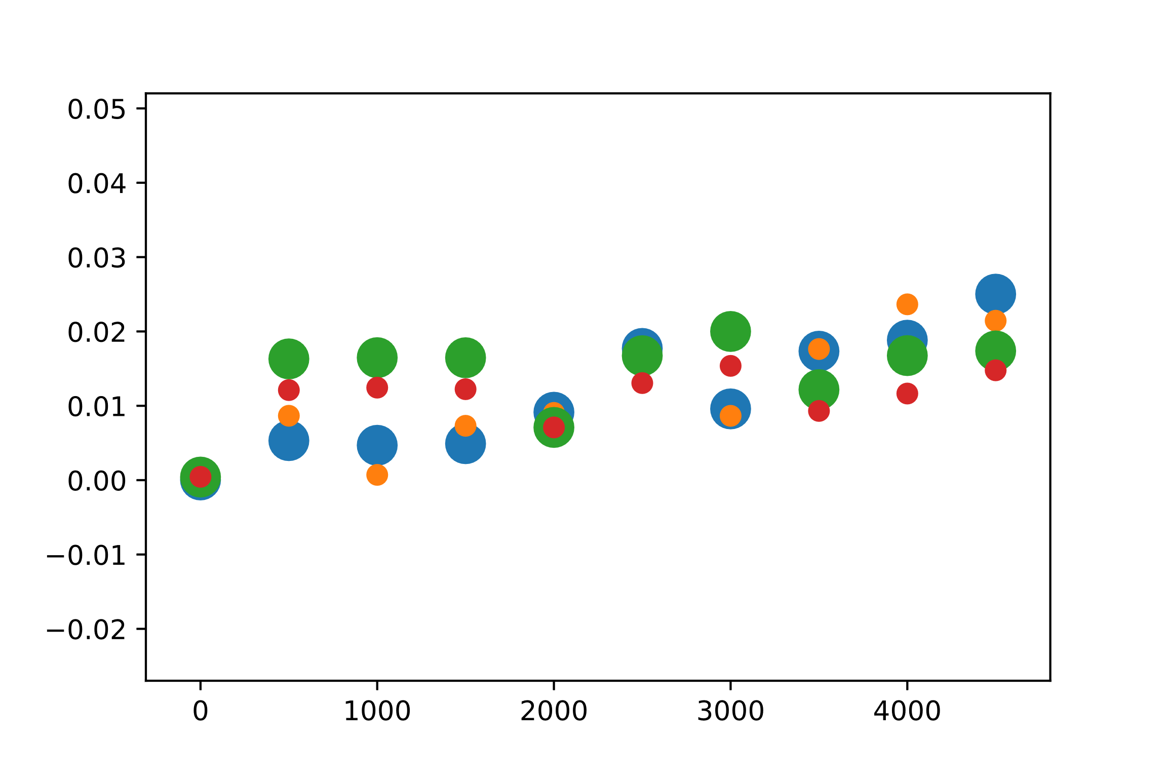
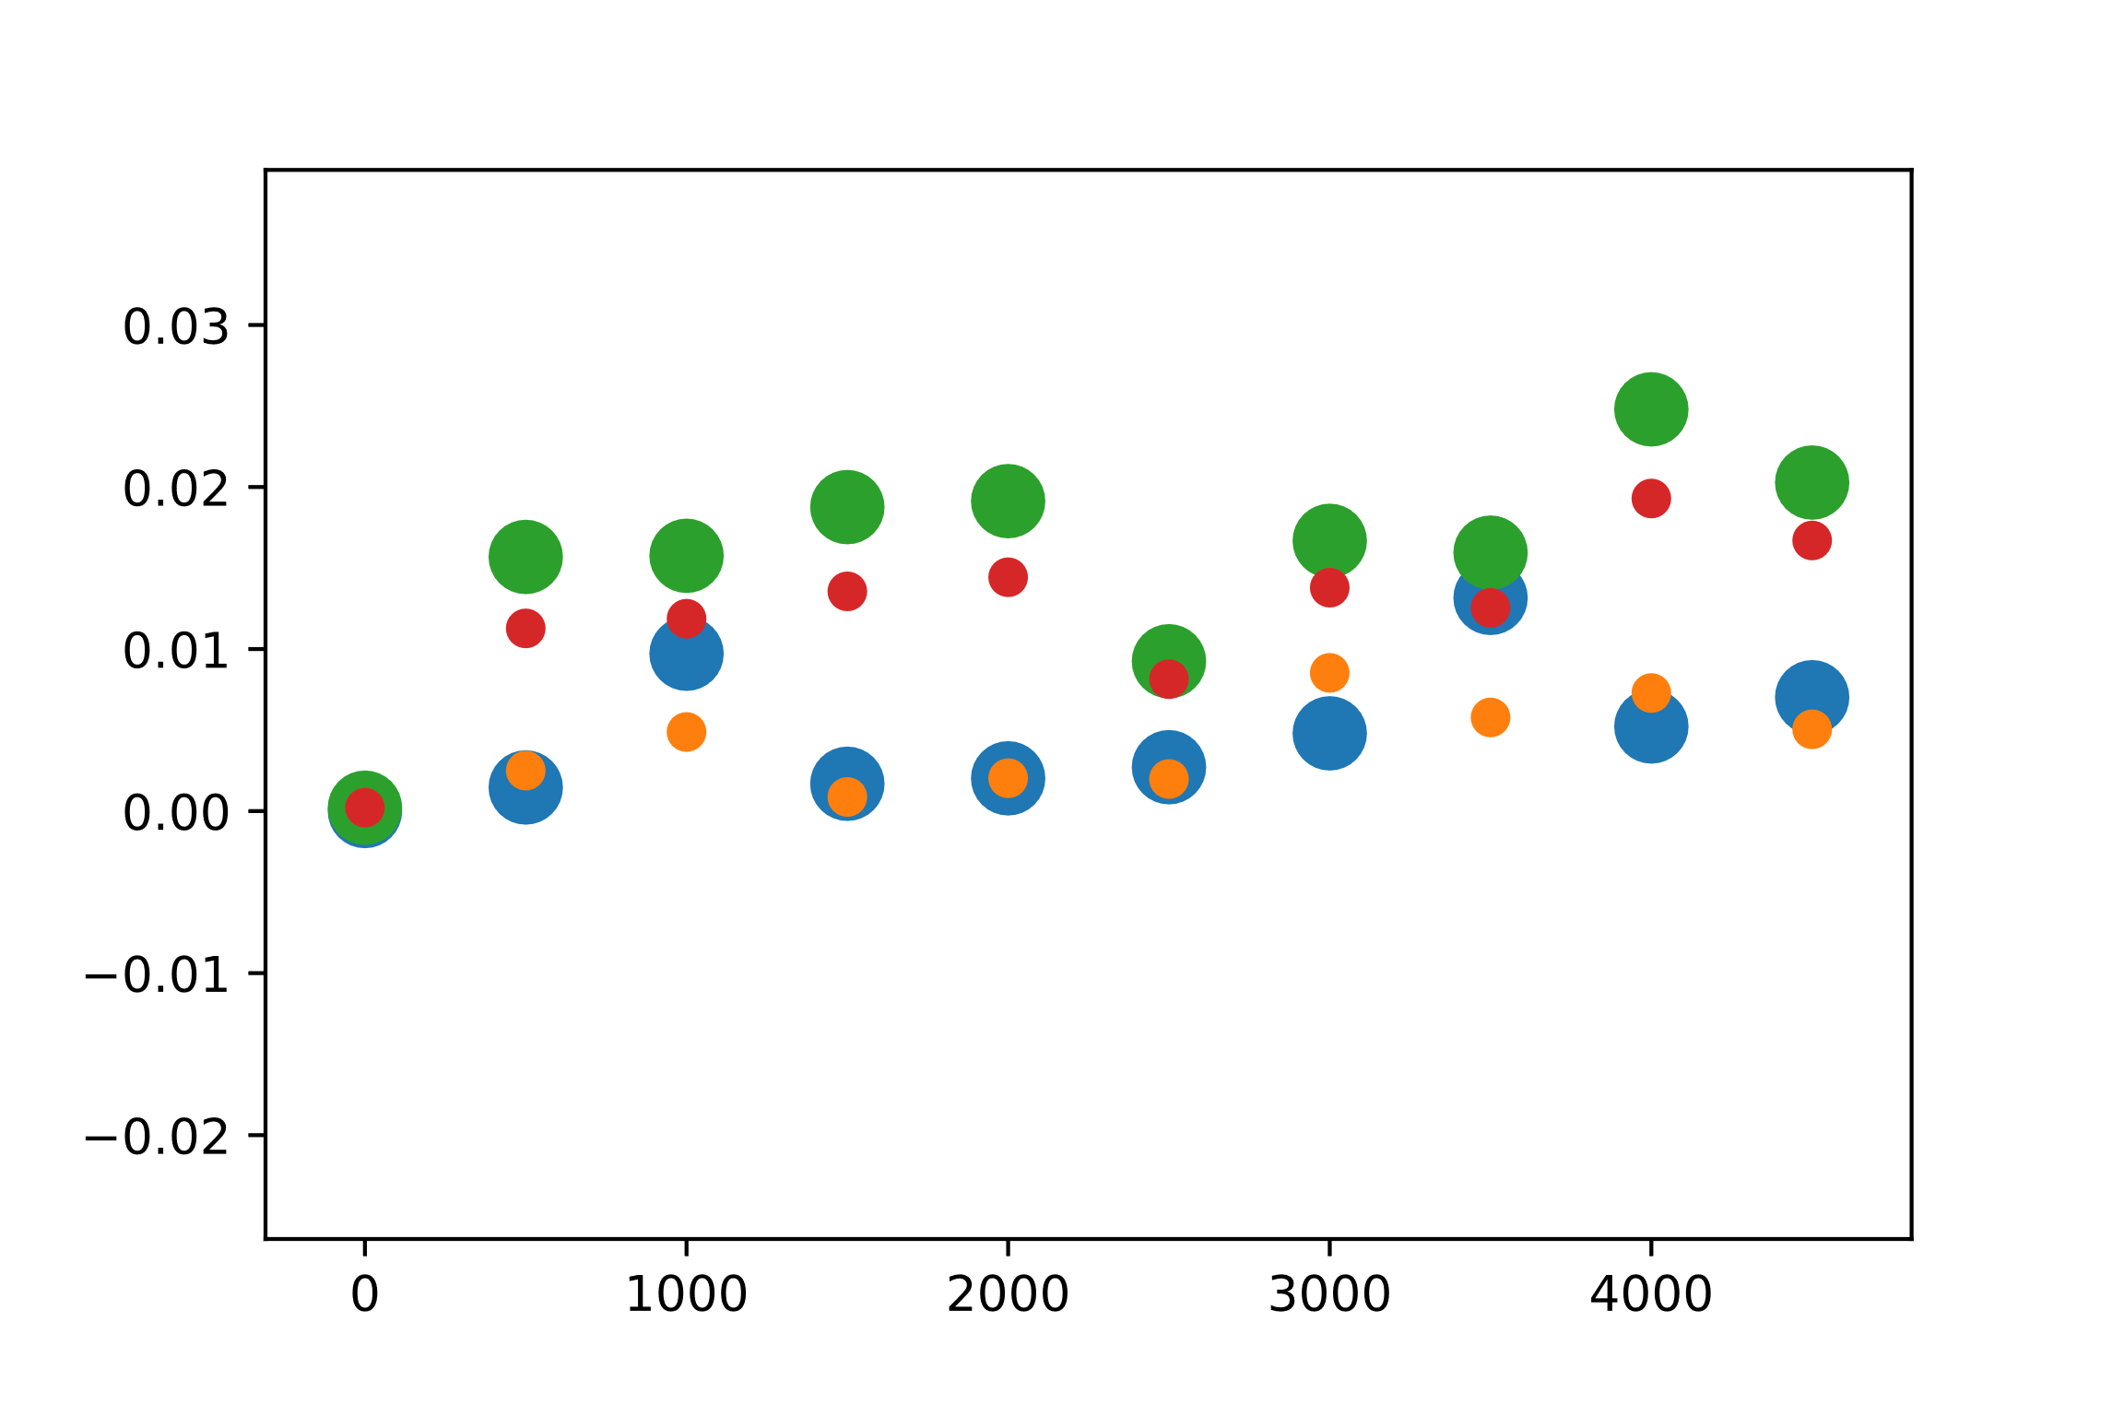
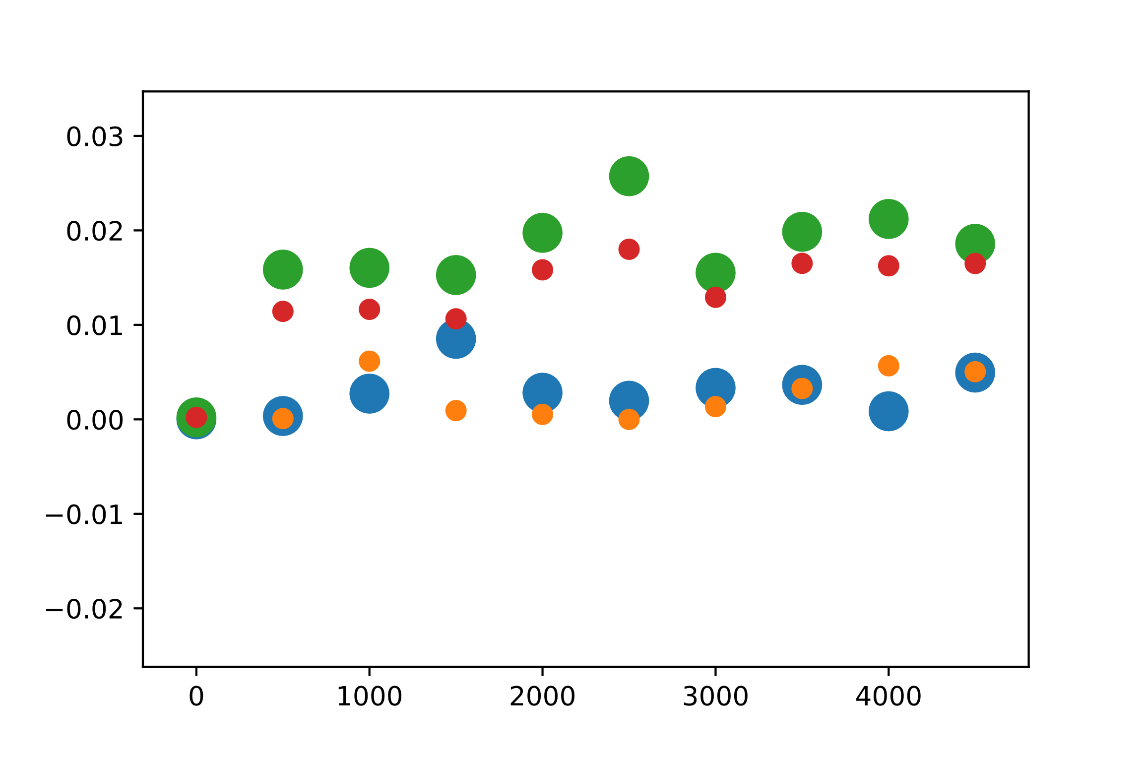
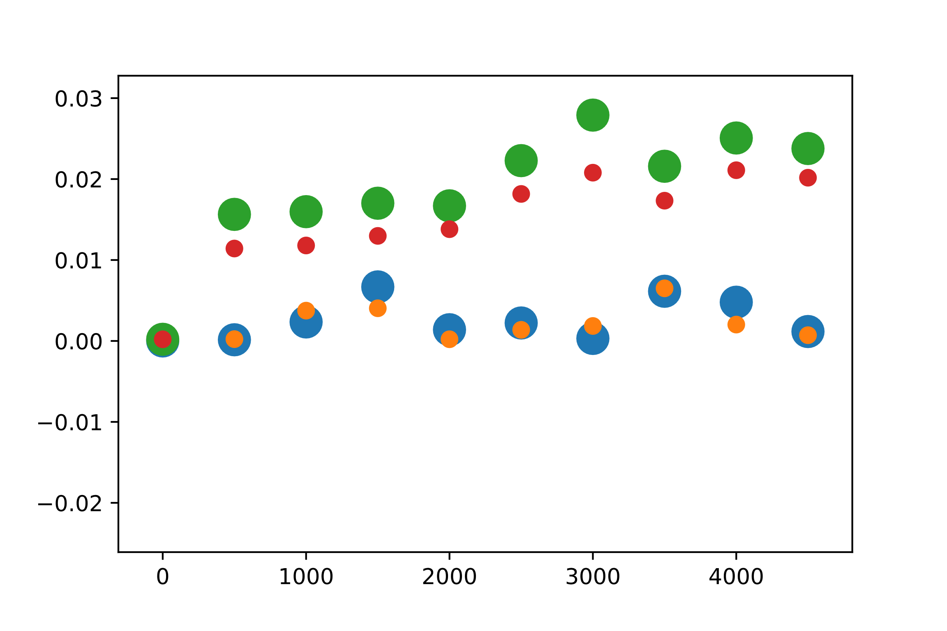
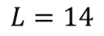
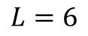
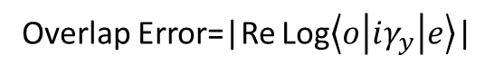
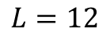
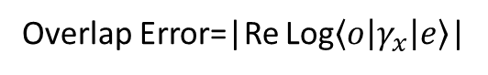
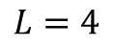
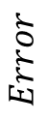
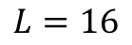
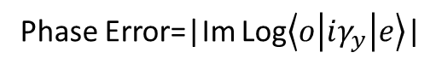
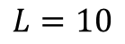
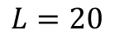
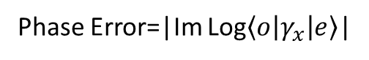
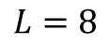
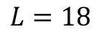
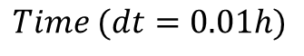
$$L=4$$
$$L=6$$
$$L=8$$
$$Error$$
Phase Error=|Im Log$\left\langle o | γ_{x} | e\right\rangle$|
Phase Error=|Im Log$\left\langle o | iγ_{y} | e\right\rangle$|
Overlap Error=|Re Log$\left\langle o | γ_{x} | e\right\rangle$|
$$Time (dt=0.01h)$$
Overlap Error=|Re Log$\left\langle o | iγ_{y} | e\right\rangle$|
$$L=10$$
$$L=12$$
$$L=14$$
$$L=16$$
$$L=18$$
$$L=20$$

Slide 4
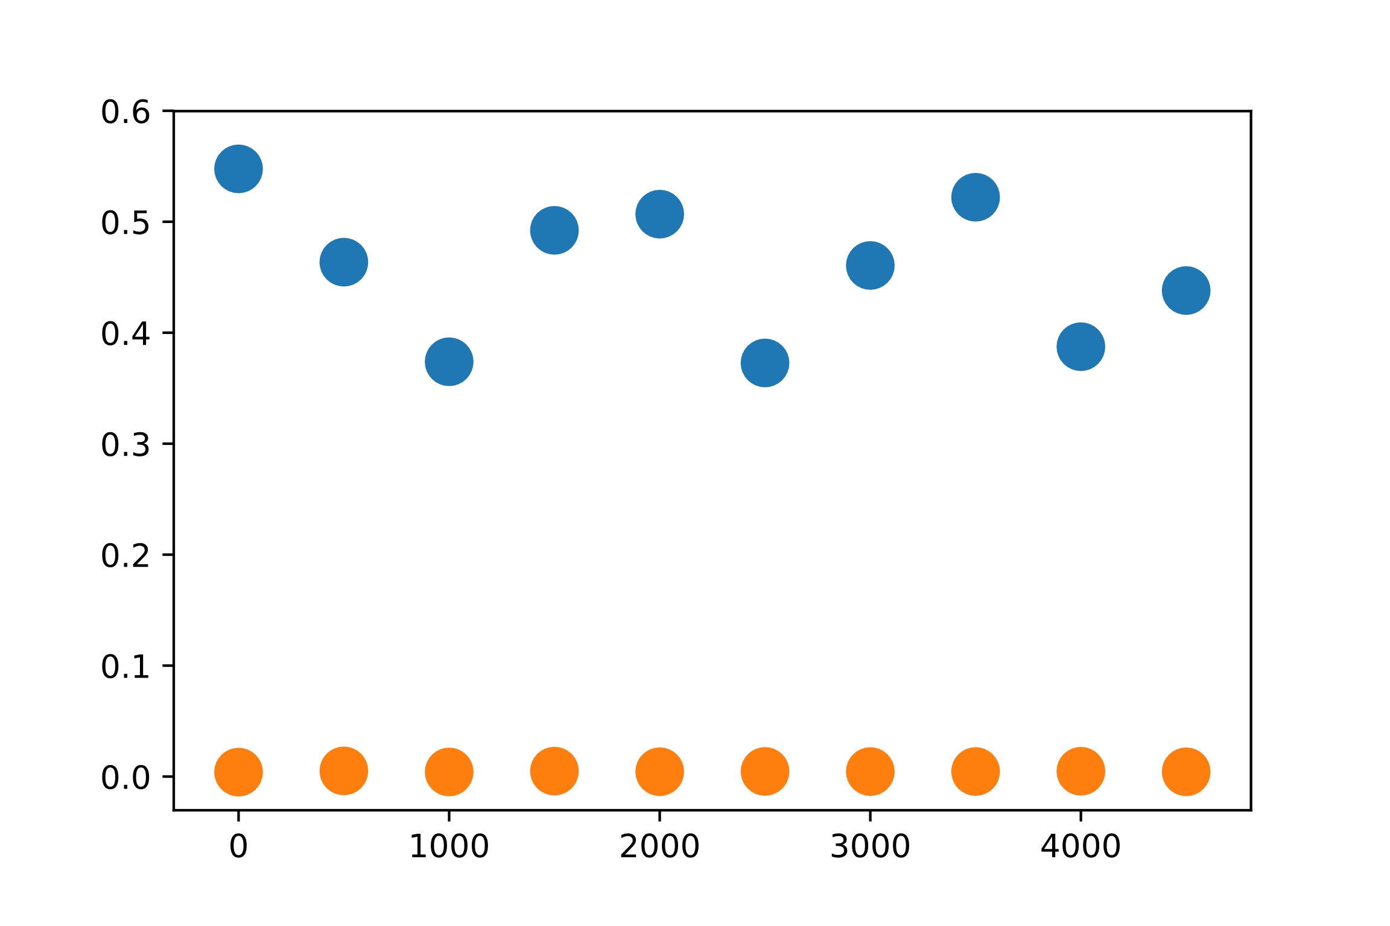
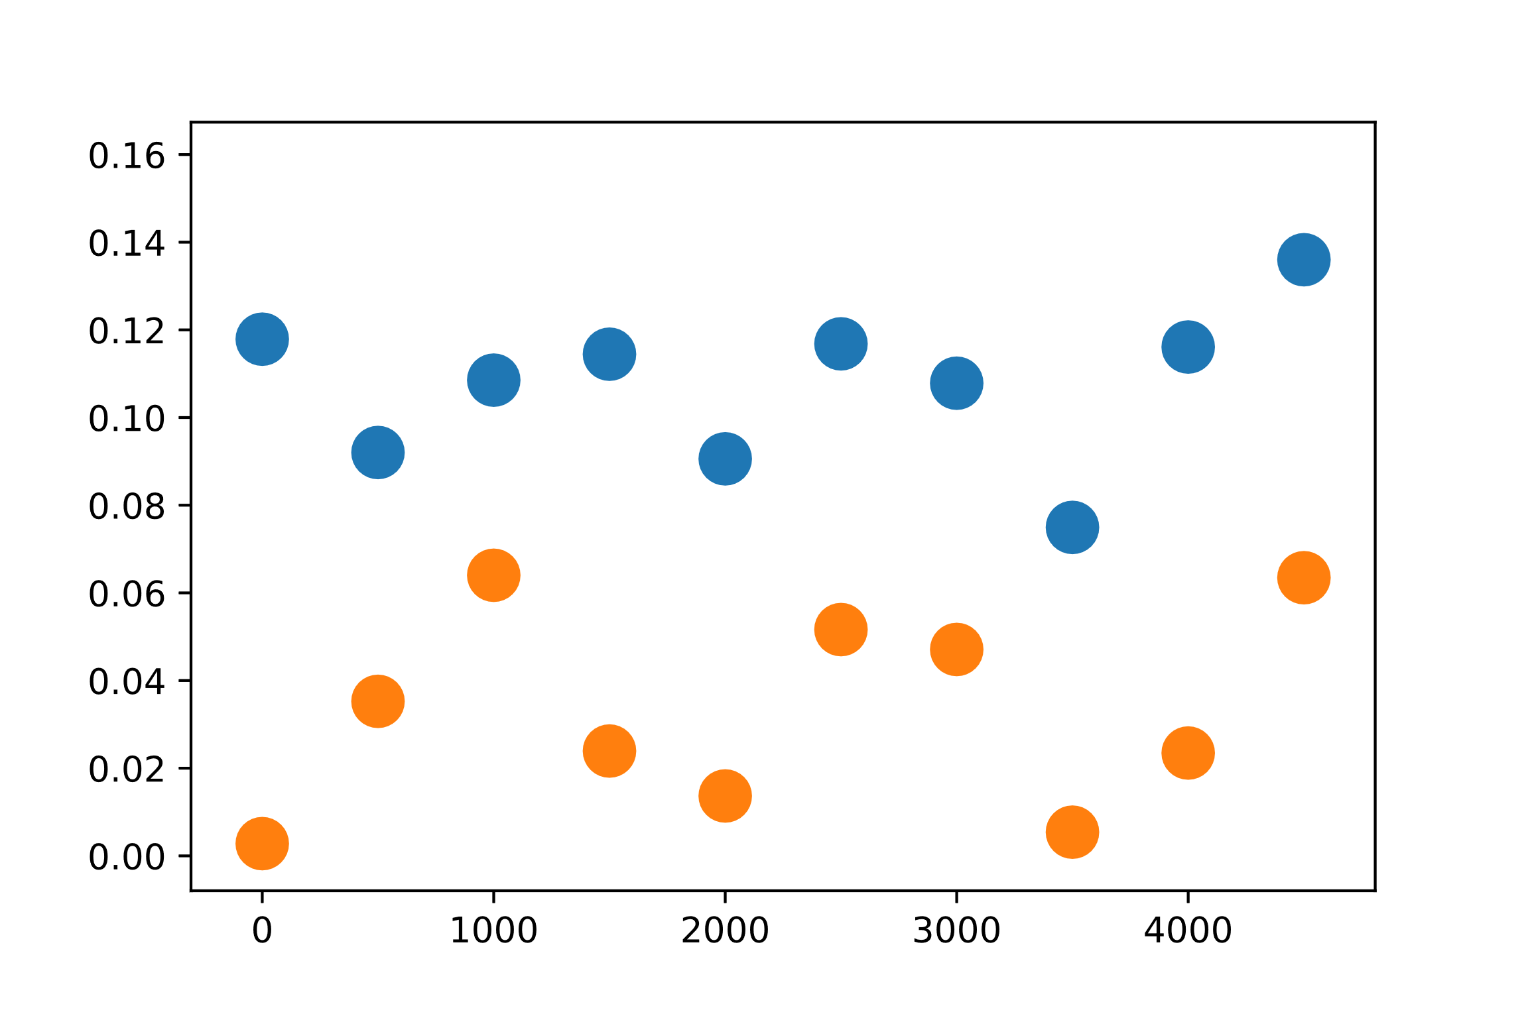











Parity Shift=1-|$\left\langle e | iγ_{x}γ_{y} | e\right\rangle |$
$$Parity Shift$$
Parity Shift=1-|$\left\langle o | iγ_{x}γ_{y} | o\right\rangle |$
$$Time (dt=0.01h)$$

Slide 5























$$t=5$$
$$t=10$$
$$t=15$$
$$t=20$$
$$Error$$
$Length$
$$t=25$$
$$t=30$$
$$t=35$$
$$t=40$$
$$t=45$$
$$t=50$$
Phase Error=|Im Arg$\left\langle o | γ_{y} | e\right\rangle$|

Slide 6




















$$t=5$$
$$t=25$$
$$t=15$$
$$t=50$$
$$Parity Shift$$
$Length$
$$t=5$$
$$t=25$$
$$t=15$$
$$t=50$$
Parity Shift=1-|$\left\langle e | iγ_{x}γ_{y} | e\right\rangle |$
Parity Shift=1-|$\left\langle o | iγ_{x}γ_{y} | o\right\rangle |$

Slide 7























T$=5$
$$t=10$$
$$t=15$$
$$t=20$$
$$Log Error$$
$Length$
$$t=25$$
$$t=30$$
$$t=35$$
$$t=40$$
$$t=45$$
$$t=50$$
Phase Error=|Im Log$\left\langle o | γ_{y} | e\right\rangle$|

Slide 8
















$$t=5$$
$$t=25$$
$$t=15$$
$$t=50$$
$$Log Parity Shift$$
$Length$
$$t=5$$
$$t=25$$
$$t=15$$
$$t=50$$
Log Parity Shift=log(1-|$\left\langle e | iγ_{x}γ_{y} | e\right\rangle |)$
Log Parity Shift=log(1-|$\left\langle o | iγ_{x}γ_{y} | o\right\rangle |)$

Slide 9
List of things John will definitely not forget to DO
Check total parity at the end of run
Write down all that shit on Roger’s board
Check Energy difference of ground states for V=0 and V=Vmax
For every plot check n=0
For Umax=0
As a function of Bond Dimension

